Slide 1
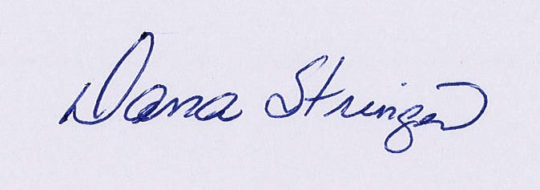
Certificate of Participation
2018 - 2019
2 Hours Technical Awareness and
8 Hours Professional Development
Awarded to
________________________
Given on February 21 -22, 2019
____________________
Dana Stringer, State HOSA Advisor
State Department of Education

